Slide 1
Digital Images and Vision
Instructor: Mohammad Hasan
Office: 13-240
10/14/26
Notes:
Welcome and Introductions

Slide 2
Overview
Digital Images
Digital Image Processing and Kernels
CNNs

Slide 3
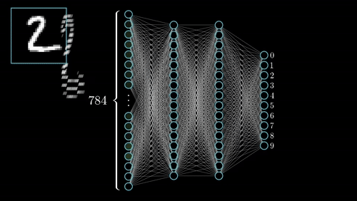
Neural Networks for Regression and Classification
So far, we have seen how neural networks are used for regression and classification problems.
In all these problems, features were either numerical or categorical (can be converted to numbers using One-Hot Encoding).
What if we deal with images?
How can we classify a handwritten digit?

Slide 4


Digital Images (monochrome)
Monochrome images: grey-scale images.
Digital images are made of pixels.
Pixel information is stored in a 2D array
White pixels: 255
Black pixels: 0
Greys: 1-254
980 px
980 px

Slide 5

Digital Images (Color Images)
Colored images are composed of different channels.
Colored images are made of RGB components (Red, Green, Blue).
Each components has its own “channel”
Colored Images are stored in 3D arrays.

Slide 6





Colored Images Representation

Slide 7
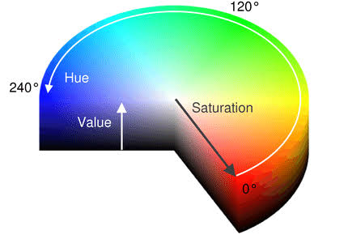
Other Color Representation
Color images can be represented with RGB triplets.
Another common alternative is HSV:
Hue: color family
Saturation: vibrancy or color intensity
Value: brightness
Hue is a useful tool to identify colors in images.

Slide 8
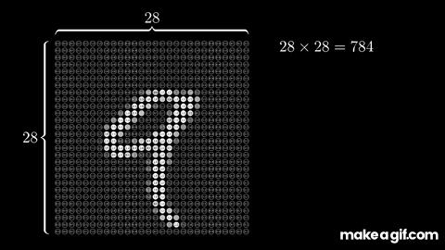
Images for Machine Learning
We may be tempted to utilize grey scale images for machine learning.
Consider a small 28 x 28 pixel image.
The image can be flattened into a vector of 784 elements (each is a feature)
Notes:
If the next layer is as big as input: you have N^2 parameters: 614,656 from one layer …

Slide 9
Is that it? Just Flatten Images?

Slide 10
Processing Images
Prior to machine learning, images were studied using image processing techniques.
These techniques utilized matrix operations on images
Software like Photoshop applies filters using “masks” and “kernels”.
These filters are applied through a convolution operation

Slide 11
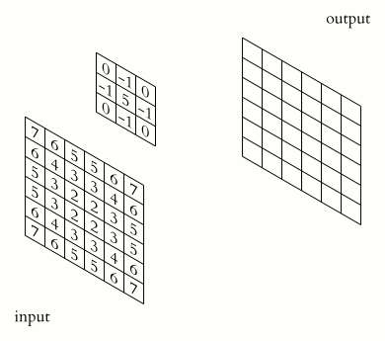
Masks/Kernels
A mask is an array (which is typically smaller than the image)
The mask is applied to parts of the image.
The mask slides through the image with a defined stride.
A new image is constructed after the mask is applied.

Slide 12
The Convolution Operation

Slide 13
The Convolution Operation

Slide 14



The Convolution Operation
1/9
1/9
1.9
0
0
0
0
0
0
0
0
1/9
1/9
1/9
200
10
200
200
200
200
1/9
1/9
1/9
10
50
50
50
200
200
0
0
0
0
0
0
0
0
200
200
50
50
10
200
200
200
200
10
10
10
0
0
0
0
0
0
0
0

Slide 15
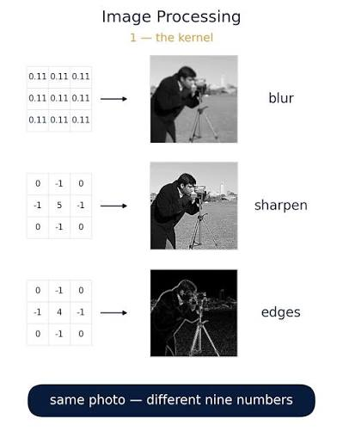
Common kernels
Blur kernel: averages the colors from surrounding pixels.
Sharpen kernel: increases contrast. Shows local details.
Edge detection kernel: detect edges in images due to color contrast.

Slide 16
What if kernels can be learned?
If kernels can extract information from images, why not create custom kernels?
Advantage: kernels are small. A 3x3 kernel can be used on much bigger images.
Hope: apply multiple kernels to an image to extract all needed information to “understand” the image.

Slide 17
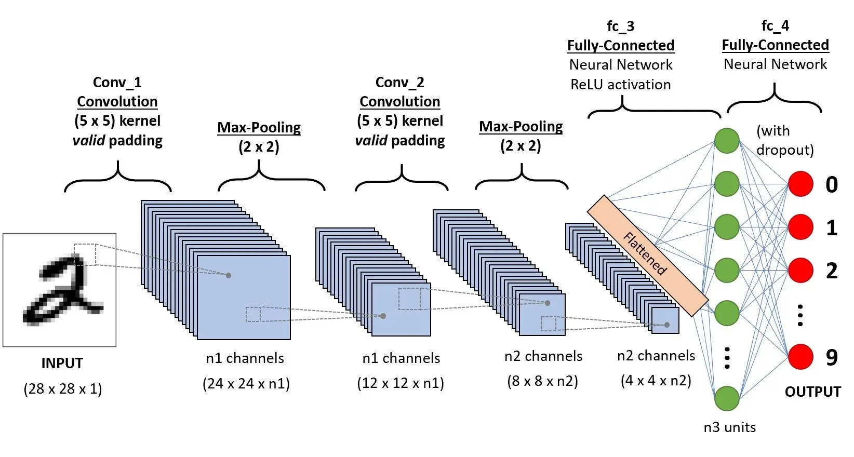
Convolutional Neural Networks (CNNs)

Slide 18
CNNs
The state of the art (until very recently) for vision.
Efficient, spatial invariant architecture.
Able to utilize spatial information.
Can utilize deep architecture and learn with gradient descent.
What are the parameters in CNNs?
Notes:
Parameters:
All kernel cell values.
Weights and biases for the fully connected neural network in the end

Slide 19





Operations in a CNN
Applying d kernels with s stride.

Slide 20





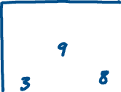

Operations in a CNN
Pooling

Slide 21










Sample CNN: Applying kernels and pooling

Slide 22



Sample CNN: Applying kernels and pooling

Slide 23










Sample CNN: Full Implementation

Slide 24
References
Materials from this handout used Machine Learning, A First Course for Engineers and Scientists by Lindholm et. al (March 4th, 2026 version), section 6.3 as a reference. Access to this document is free at the publishers’ GitHub page.
The following was also used for materials: Artificial Intelligence: A Modern Approach, Russel and Norvig, 4th edition, section 21.3.
Data Driven Science and Engineering: Machine Learning, Dynamical Systems and Control, Brunton and Kutz, 2nd edition, section 6.5.

Slide 25
Extra notes

